Slide 1
Duality
for
linear programming

Slide 2
Illustration of the notion
Consider an enterprise
producing r items:
f_{k} = demand for the item k =1,…, r
using s components:
h_{l} = availability of the component l = 1,…, s
The enterprise can use any of the n process (activities):
x_{j} = level for using the process j = 1,…, n
c_{j} = the unit cost for using the process j = 1,…, n
The process j
produces e_{kj} units of the item k =1,…, r
uses g_{lj} units of the component l = 1,…, s
for each unit of its use

Slide 3
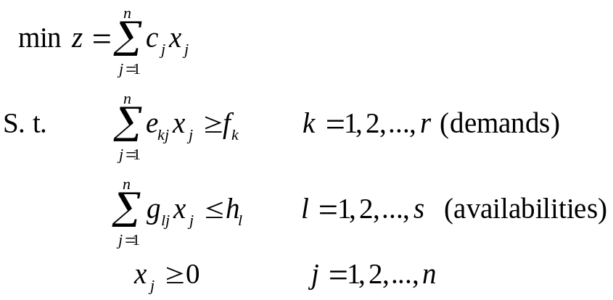
Illustration of the notion
Consider an enterprise
producing r items:
f_{k} = demand for the item k =1,…, r
using s components:
h_{l} = availability of the component l = 1,…, s
The enterprise can use any of the n process (activities):
x_{j} = level for using the process j = 1,…, n
c_{j} = the unit cost for using the process j = 1,…, n
The process j
produces e_{kj} units of the item k =1,…, r
uses g_{lj} units of the component l = 1,…, s
each time it is used at level 1
The enterprise problem: determine the level of each process for satisfying the demand without exceeding the availabilities in order to minimize the total production cost.
Model

Slide 4
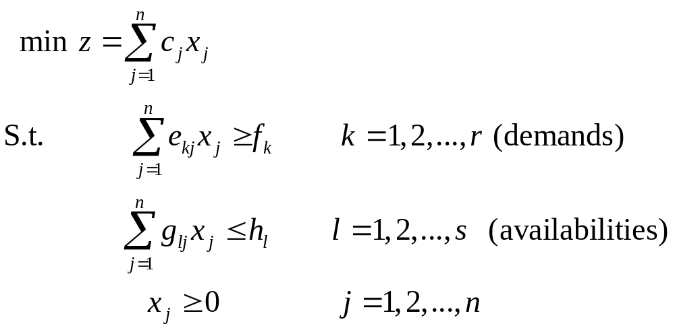
Illustration of the notion
A business man makes an offer to buy all the components and to sell the items required by the enterprise to satisfy the demands.
He must state proper unit prices (to be determined) to make the offer interesting for the enterprise:
v_{k} item unit price k = 1, 2, … , r
w_{l} component unit price l = 1, 2, …, s.
v_{k}
w_{l}

Slide 5
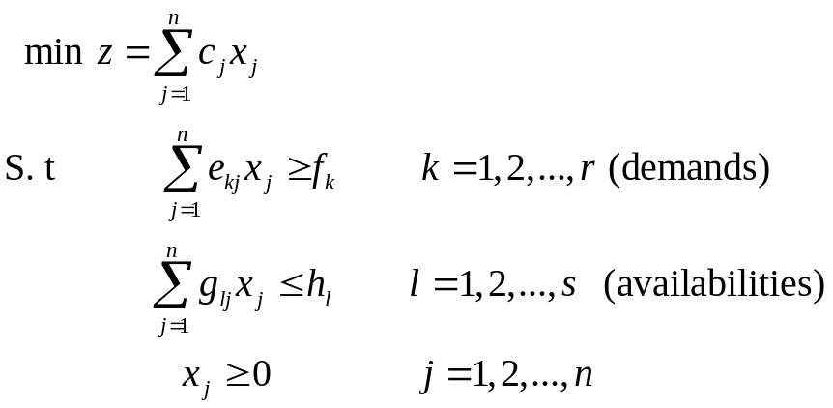
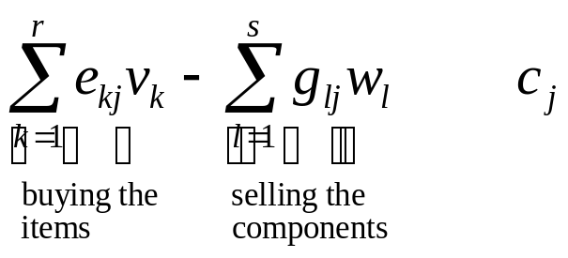
Illustration of the notion
The business man must state proper unit prices (to be determined) to make the offer interesting for the enterprise
To complete its analysis, the enterprise must verify that for each process j, the cost of making business with him is smaller or equal than using the process j. But the cost of making business with him is equal to the difference between buyng the items required and selling the components unused in order to simulate using one unit of process j (c_{j} ).
v_{k}
w_{l}
≤

Slide 6
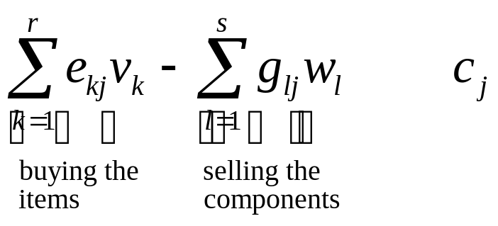
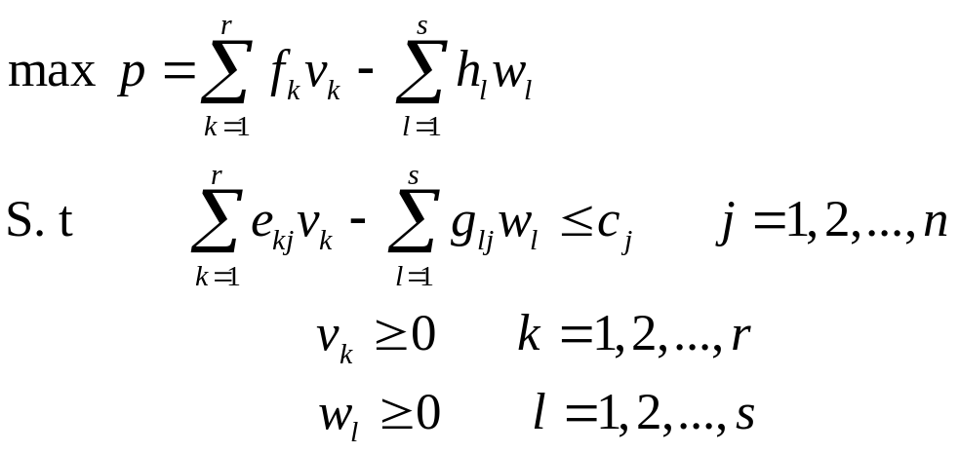
Illustration of the notion
≤
The business man problem is to maximize his profit while maintaining the prices competitive for the enterprise

Slide 7
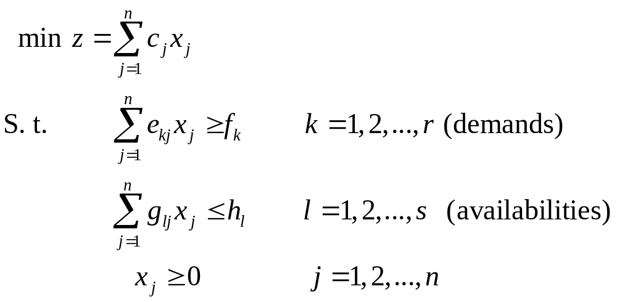
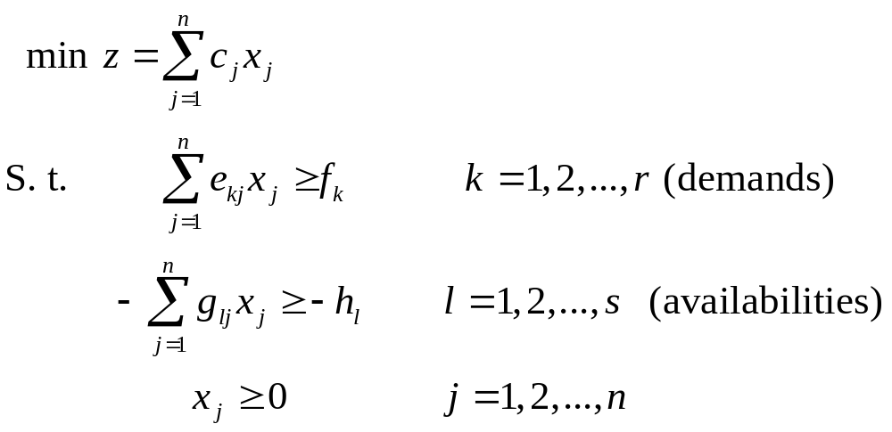

Illustration of the notion
The enterprise problem: multiply the availability constraints by -1

Slide 8

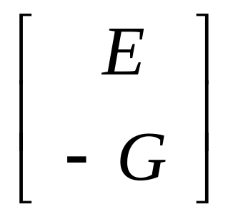

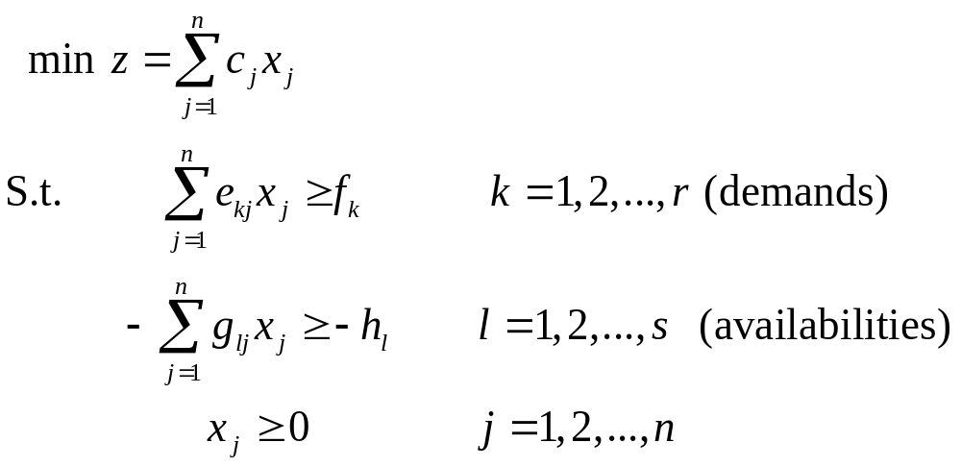


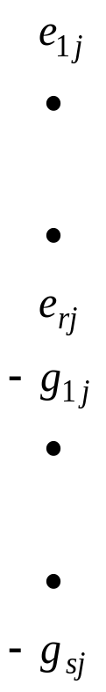

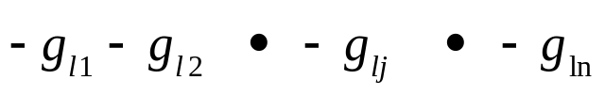

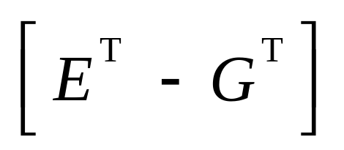
Enterprise problem
Business man problem

Slide 9

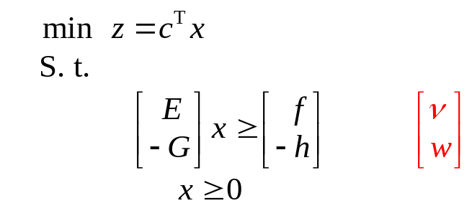
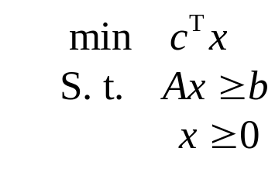

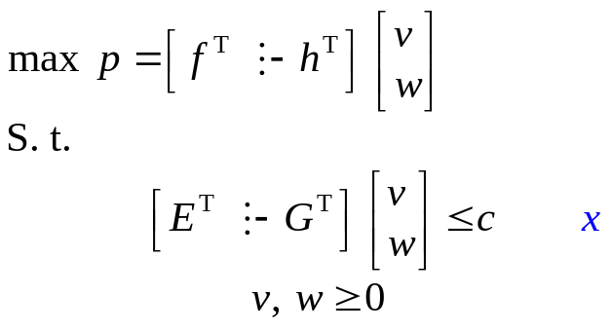
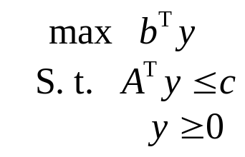
Primal
Dual

Slide 10
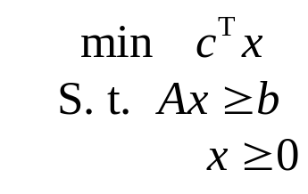
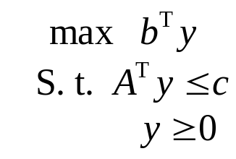
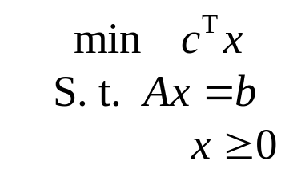
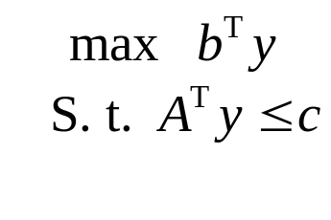
Primal dual problems
Linear programming problem specified with equalities
Linear programming in standard form
Primal problem
Dual problem
y
x
Primal problem
Dual problem
y
x

Slide 11
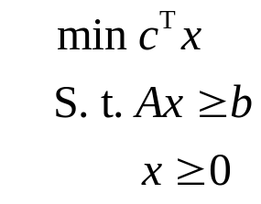
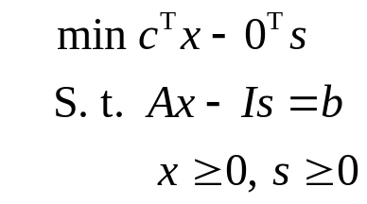
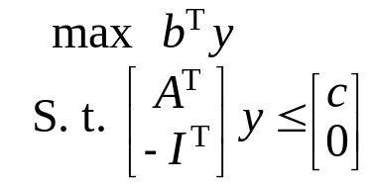
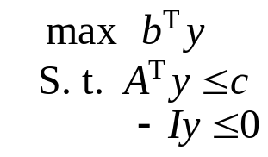
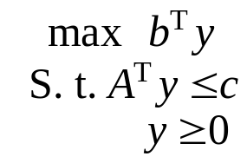

Slide 12
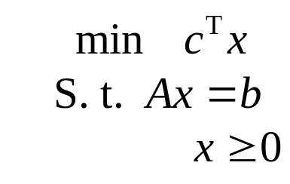
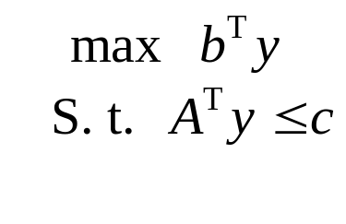
Duality theorems
It is easy to show that we can move from one pair of primal-dual problems to the other.
It is also easy to show that the dual of the dual problem is the primal problem.
Thus we are showing the duality theorems using the pair where the primal primal is in the standard form:
primal
Dual

Slide 13

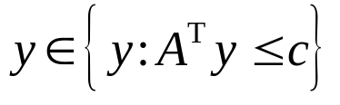

Duality theorems
Weak duality theorem
If (i.e., x is feasible for the primal problem) and
if (i.e., y is feasible for the dual problem), then
Proof Indeed,

Slide 14
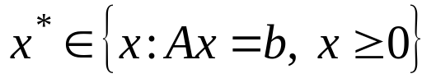
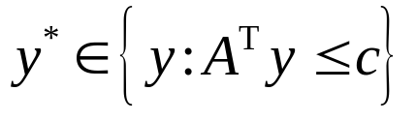


Duality theorems
Corollary If and , and if
, then x* and y* are optimal solutions for the primal and dual problems, respectively..
Proof It follows from the weak duality theorem that for any feasible solution x of the primal problem
Consequently x* is an optimal solution of the primal problem.
We can show the optimality of y* for the dual problem using a similar
proof.

Slide 15


Duality theorems
Strong duality theorem If one of the two primal or dual problem has a finite value optimal solution, then the other problem has the same property, and the optimal values of the two problems are equal. If one of the two problems is unbounded, then the feasible domain of the other problem is empty.
Proof The second part of the theorem follows directly from the weak duality theorem. Indeed, suppose that the primal problem is unbounded below, and thus c^{T}x→ – ∞. For contradiction, suppose that the dual problem is feasible. Then there would exist a solution ,
and from the weak duality theoren, it would follow that ; i.e., b^{T}y would be a lower bound for the value of the primal objective function c^{T}x, a contradiction.

Slide 16
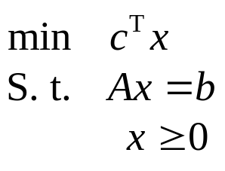
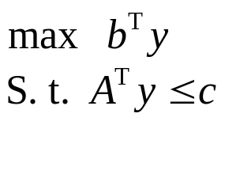
Complementary slackness theory
We now introduce new necessary and sufficient conditions for a pair of feasible solutions of the primal and of the dual to be optimal for each of these problems.
Consider first the following pair of primal-dual problems.
primal
Dual
x

Slide 17
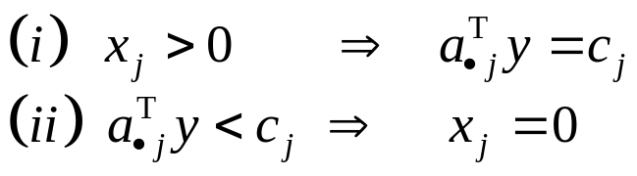
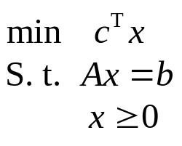
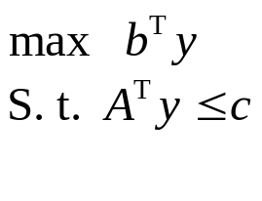



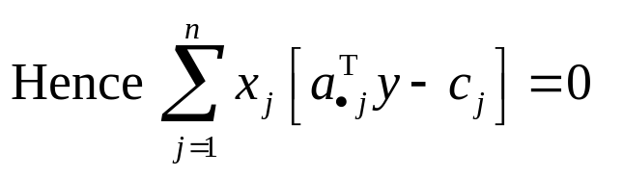
Complementary slackness theory
Complementary slackness theorem 1
Let x and y be feasible solution for the primal and the dual, respectively. Then x and y are optimal solutions for these problems if and only if for all
j = 1,2,…,n
Poof First we prove the sufficiency of the conditions. Assume that the conditions (i) et (ii) are satisfied for all j=1,2,…,n. Then

Slide 18
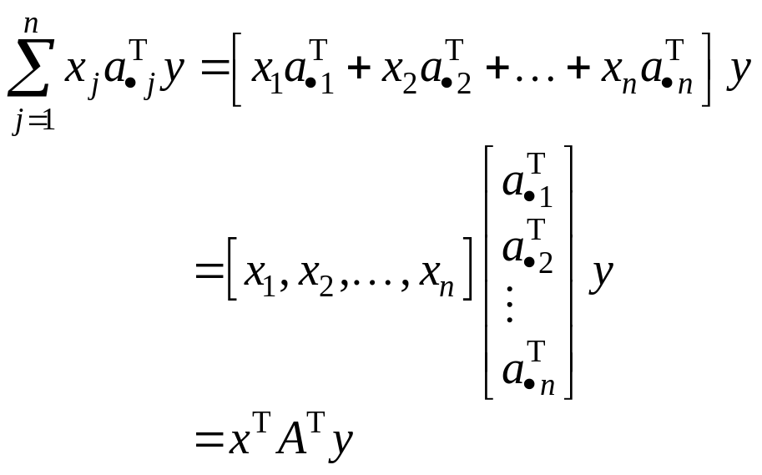
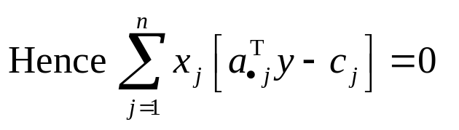
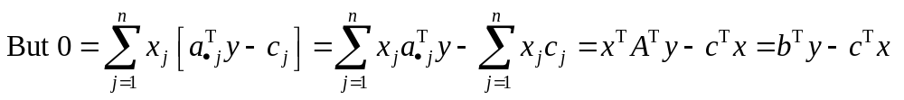

Complementary slackness theory
Consequently
and the corollary of the weak duality theorem implies that x et y are optimal solutions for the primal and the dual problems, respectively.

Slide 19


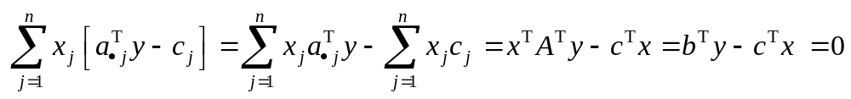
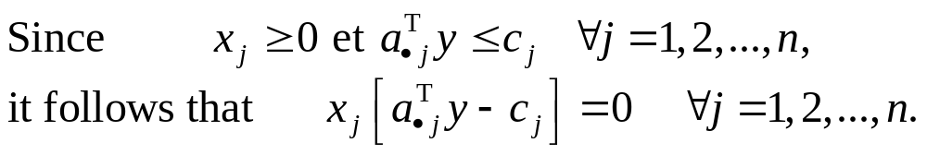

Complementary slackness theory
Now we prove the necessity of the sonditions. Suppose that the solutions x et y are optimal solutions for the primal and the dual problems, respectively, and
Then referring to the first part of the theorem

Slide 20
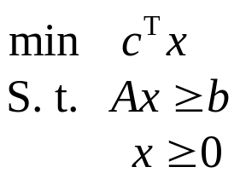
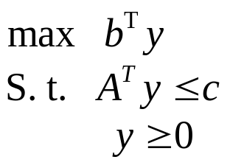
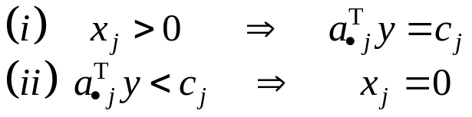
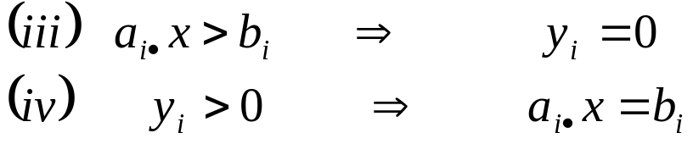
Complementary slackness theory
Now consider the other pair of primal-dual problems
Complementary slackness theorem 2
Let x and y be feasible solution for the primal and dual problems, recpectively. Then x and y are opyimal solutions of these problems
if and only if
for all j = 1,2,…,n for all i=1,2,…,m
y
x

Slide 21
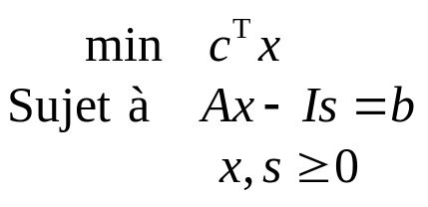
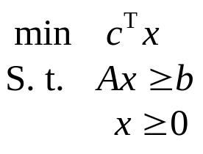
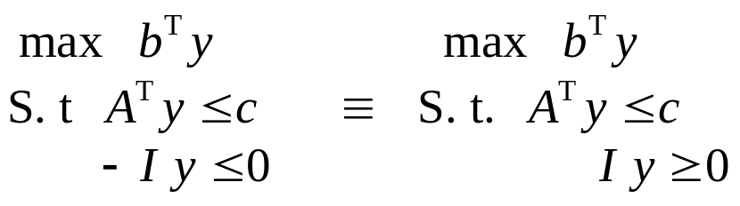
Complementary slackness theory
Proof This theorem is in fact a corollary of the complementary slackness theorem 1. Transform the primal problem into the standard form using the slack variables s_{i} , i=1,2,…,m:
The dual of the primal problem in standard form

Slide 22
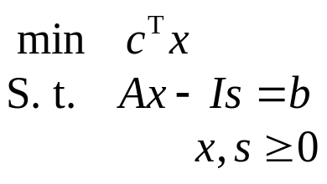



Complementary slackness theory
Use the result in the preceding theorem to this pair of primal-dual problems
For j=1,2,…,n
and for i=1,2,…,m
y
x
s

Slide 23



Complementary slackness theory
For j=1,2,…,n
and for i=1,2,…,m
and then the conditions become

Slide 24

Dual simplex algorithm
The dual simplex method is an iterative procedure to solve a linear programming problem in standard form.

Slide 25




Dual simplex algorithm
At each iteration, a basic infeasible solution of problem is available, except at the last iteration, for which the relative costs of all variables are non negatives.
Exemple

Slide 26




Dual simplex algorithm
Analyse one iteration of the dual simplex algorithm, and suppose that the current solution is as follows:

Slide 27


Leaving criterion

Slide 28

Leaving criterion

Slide 29

Leaving criterion

Slide 30



Leaving criterion

Slide 31




Leaving criterion

Slide 32


Leaving criterion

Slide 33

Leaving criterion

Slide 34





Entering criterion

Slide 35

Pivot
To obtain the simplex tableau associated with the new basis where the entering variable x_{s} remplaces the leaving variable x_{r} we complete the pivot on the element

Slide 36






Exemple
x is the leaving variable, and consequantly, the pivot is completed in the first row of the tableau
h is the entering variable, and consequently, the pivot is completed on the element -1/4
After pivoting, the tableau becomes
This feasible solution
is optimal

Slide 37

Convergence when the problem is non degenerate
Non degeneracy assumption:
the relative costs of the non basic variables are positive at each iteration
Theorem: Consider a linear programming problem in standard form.
If the matrix A is of full rank, and if the non degeneracy assumption is verified, then the dual simplex algorithm terminates in a finite number of iterations.

Slide 38


Proof:
Since the rank of matrix A is equal to m, then each basic feasible solution includes m basic variables strictly positive (non degeneracy assumption).

Slide 39








The influence of pivoting on the objective function during an iteration of the simplex
→
Substact from

Slide 40

Then and the value of the objective function increases stricly at each iteration.
Consequently, the same basic non feasible solution cannot repeat during the completion of the dual simplex algorithm.
Since the number of basic non feasible solution is bounded, it follows that the dual simplex algorithm must be completed in a finite number of iterations.

Slide 41
Comparing
(primal) simplexe alg. and dual simplexe alg.
Simplex alg.
Search in the feasible domain
Search for an entering variable to
reduce the value of the objective function
Search for a leaving variable preserving
the feasibility of the new solution
Stop when an optimal solution is found
or when the problem is not bounded
below
Dual simplex alg.
Search out of the feasible domain
Search for a leaving variable to eliminate
a negative basic variable
Search for an entering variable preserving
the non negativity of the relative costs
Stop when the solution becomes feasible
or when the problem is not feasible

